Slide 1
The Challenge Remains the Same … But The Approach Must Change
The Retail Challenge
To Win, Retailers Must
Get Real
Right Product
Right Place
Right Time
Right Price
Right Way
Real Focused
Real Efficient
Real Smart
Real Close
All in Real Time
Sustainable growth will come from an increased understanding of consumers needs and a mixture of “Art” and “Science”

Slide 2
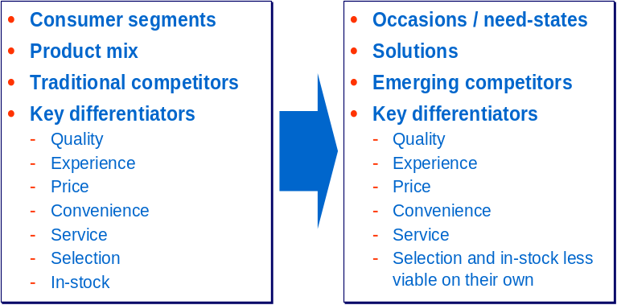
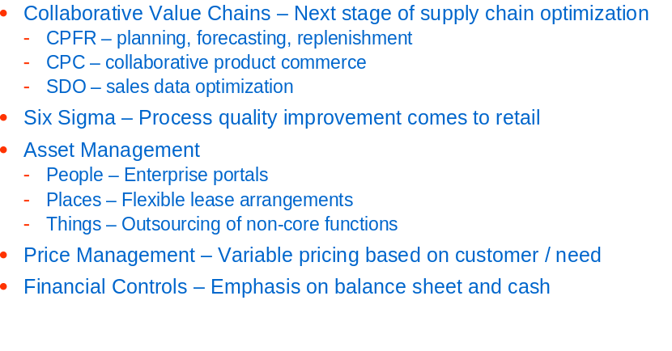
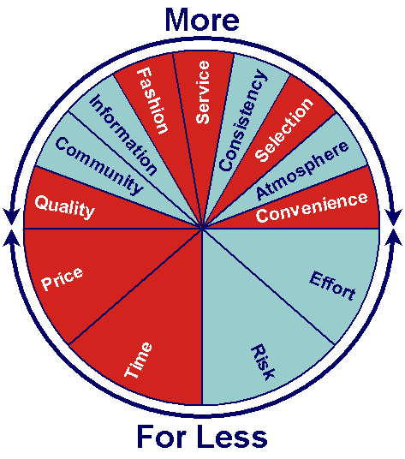
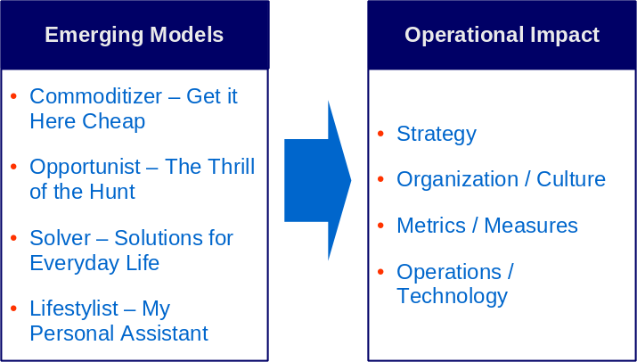
A mixture of “Art” and “Science” is required
Real Focused: Defining Positioning Elements
Real Efficient: Across the Enterprise
Real Smart: Multi-Plex Consumer Value Drivers
Real Close: Business Model Alignment

Slide 3

Real Time Retail – Driving Growth at the Point of Decision
Real-time connections with:
  Consumers
  Partners
  Stores
Significant impact on:
  Customer Service
  Inventory Management
  Pricing / Promotions
  Purchasing
Technology-enablers include:
  Collaborative Value Chains
    CPFR
    CPC
    SDO
  In-store wireless CRM
  RFID / Auto-ID

Slide 4
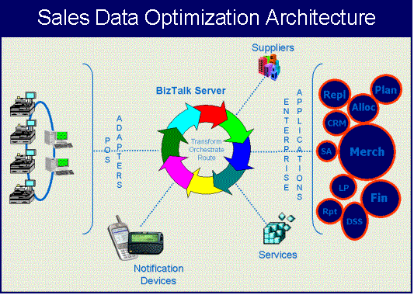
The SDO Architecture lays the foundation of data availability which can be leveraged for supply chain optimization and CRM opportunities
A scalable architecture built on the Microsoft BizTalk platform
Industry standard transaction templates and message queues
Real time data access
Flexible operating environment
  Retailer supported (In-store or Corporate)
  ASP Model
The SDO Architecture acts as a hub providing on demand access to store transactional data; allowing a variety of services to analyze, and respond to the store environment in real time

Slide 5
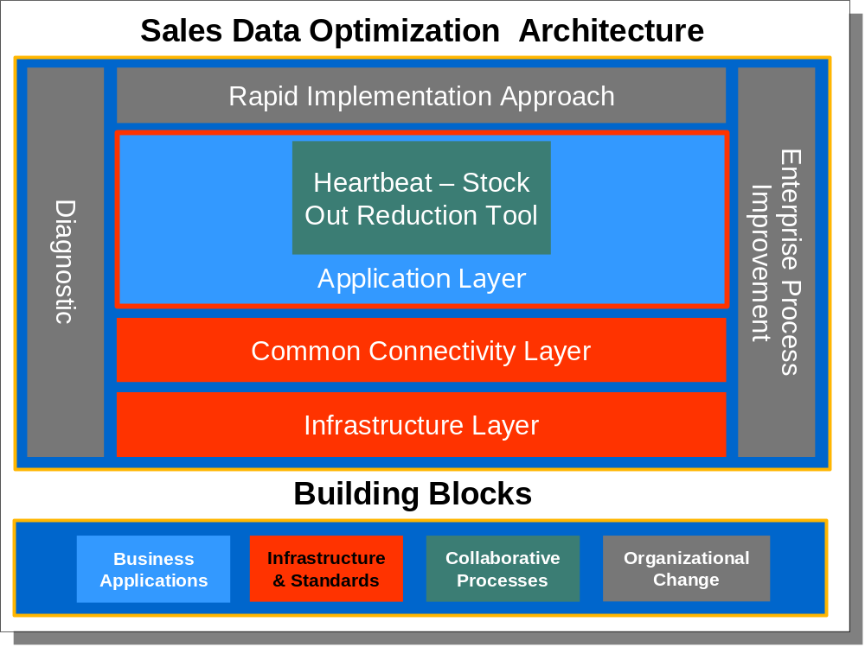
The SDO architecture lays the foundation for data availability which can be leveraged for supply chain optimization and CRM opportunities
Sales Data Optimization Architecture
Diagnostic
Rapid Implementation Approach
Enterprise Process Improvement
A scalable architecture
Industry standard transaction templates and message formats
Real time data access
Flexible operating environment
  Retailer supported (In-store or Corporate)
  ASP Model
Application Layer
Heartbeat – Stock Out Reduction Tool
Common Connectivity Layer
Infrastructure Layer
Building Blocks
Business
Applications
Infrastructure & Standards
Collaborative Processes
Organizational Change
The SDO Architecture acts as a hub providing on demand access to store transactional data; allowing a variety of services to analyze and respond to the store environment in real time

Slide 6
The Sales Data Optimization effort includes a comprehensive Rapid Implementation methodology
SDO Implementation Methodology
Analysis
Definition
Design
Construction
Deployment, Support & New Functionality

Slide 7
Analysis
SDO
Methodology
Envisioning
  Scope definition
  Identify items / categories to be tracked by “Heartbeat”
  Establish baseline metrics
Process Analysis
  Review ordering and inventory management processes
  Review current in-store stocking processes
Systems / Data Analysis
  Review existing technical environment
  Identify data sources and formats
Project Planning
  Identify project resources
  Budget FTEs
  Estimate timeline

Slide 8
Definition
SDO
Methodology
Process Definition
  Define target re-stocking process for Heartbeat items
    Resource coverage
    Item / category prioritization
  Define target inventory management processes
  Define target PO management processes
Define Tracking / Alert Requirements
  Define performance targets
  Define reporting requirements
  Define Alert requirements / formats
Technical Definition
  Data requirements definition
  System Definition (Local Server, Centralized server, ASP)
  Infrastructure Definition
  Hardware (Servers, PDA, Wireless)
Documentation & Training Definition

Slide 9
Design
SDO
Methodology
Design SDO Architecture
  Design Infrastructure
  Size Heartbeat Apps & Database
Design SDO Interfaces
  Map POS Data elements to standard DV transactions
Design Reports / Alert
  Design alert criteria / formats
  Design reports
Change Management
  Establish performance tracking processes
  Develop training program / Set training schedule
    In – Store processes
    Inventory Management / Ordering processes
Project Management
  SDO deployment plan

Slide 10
Construction
SDO
Methodology
Development
  Construct SDO Interfaces
  Construct Alert messages
  Construct reports
Testing
  Functional / Integration testing
  Performance testing
Change Management / Training
  Prepare training documents
  Train store personnel
  Knowledge transfer plans & processes
  Knowledge transfer performance measurements
Installation/Set-up
  Set-up infrastructure Install hardware / OS
  Install BizTalk / Data Ventures apps

Slide 11
Deployment, Support & New Functionality
SDO
Methodology
Pilot Set-up and Testing
  Set-up initial pilot stores
  Test pilot stores
  Go live/no go issues resolution
  Monitor Pilot Program / Resolve Issues
Deployment planning
  Continue program roll out
  Provide on going system support
Release Management
  Analyze results of project
  Identify next business functionality release

